Slide 1
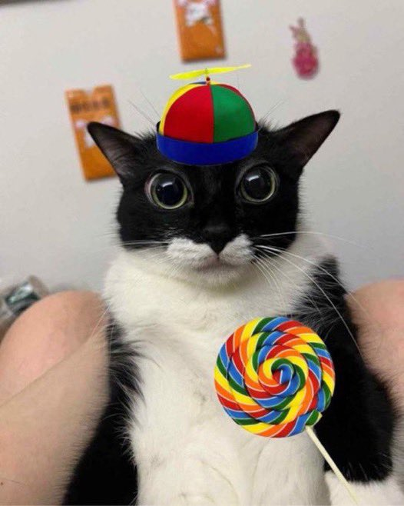

Bartholomew Binkleburg
Image Identification Software

Slide 2
Team Intro
Andrew Booth
Astrid Lutz
Mitch Wright

Slide 3
What?
We aim to give users a way to submit a search that returns a selection of clothes from our database of clothes that closely match they’re provided filters.

Slide 4
Why?
This project combines our group members' original ideas. We started by developing ideas, including AI image recognition and e-commerce. We then had the idea for an e-commerce website that incorporated AI image recognition to find similar products to an image. We will primarily try to focus on the AI image recognition of clothes since that is what we believe will be most interesting and challenging. It will push us to learn more on our own and ultimately become better while also working on something that interests us. Similar things exist, but this will be our unique rendition of the concept. In the end, we hope to have something that will be useful on its own or could be built upon to further its usefulness.
AI recognition
+
Ecommerce

Slide 5



Tech Stack
Frontend + Web server
Apache (XAMPP) + HTML/CSS/JS/PHP
Database
MySQL (via XAMPP)
AI Backend
pytorch and Flask app

Slide 6
Functional Requirements
Image Upload Capability:
The system shall allow users to upload or capture an image through the user interface. Supported formats include common types like JPG and PNG. The image file size will have restrictions to ensure optimal performance.
Image Preprocessing:
The system shall preprocess uploaded images, resizing and normalizing them to fit the input requirements of the Convolutional Neural Network (CNN).
Image Recognition via CNN:
The system shall analyze the uploaded image using a CNN model, extracting visual features and generating descriptive tags to identify the image's contents.
Database Query for Similar Products:
The system shall query the e-commerce database using the generated tags to retrieve up to at least three visually similar products from the inventory.
Display of Search Results:
The system shall display the matched products to the user, including product images, names, prices, and links to the e-commerce platforms product pages.

Slide 7
Functional Requirements Cont.
Real-Time Progress Updates:
The system shall provide users with real-time feedback on the image processing progress, such as loading indicators or status messages.
Request Cancellation and Error Handling:
The system shall allow users to cancel a current request if they submit a new one. If an error occurs (e.g., unsupported file format or failed query), the system shall notify the user with appropriate messages.
Ability to Filter Search Results:
The system shall allow users to filter results by specific criteria like price range, brand, or availability after receiving the initial results.
User Accounts
The system shall allow users to create an account where their previous searches can be accessed

Slide 8
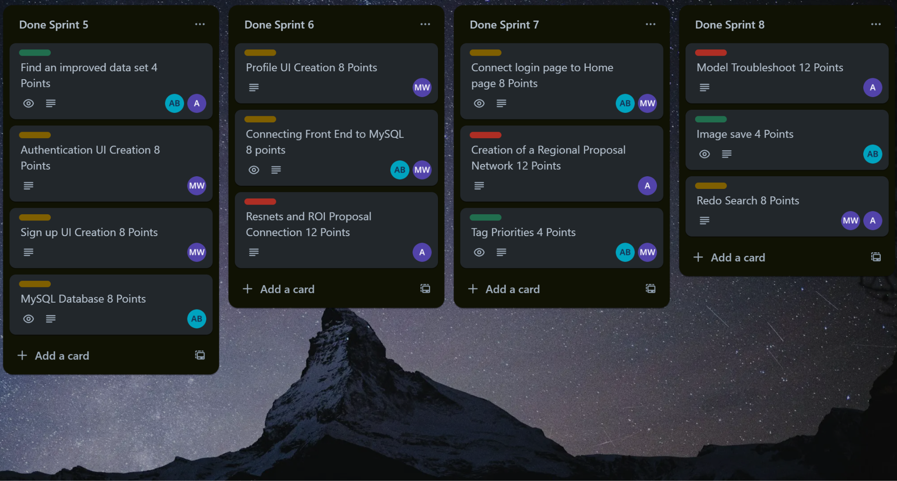

Slide 9
How It Works
User Selects Item + Color
Users can select an item type and an optional color filter.
Flask backend uses a .pkl file to:
Look for items matching the selected class (e.g., sweatshirt).
If color is selected, it checks RGB color ranges for matches.
Results are returned as images
Frontend sends request to Flask `/search`
Flask loads .pkl → Filters by class + color
Returns image filename + bounding box
Frontend displays results

Slide 10
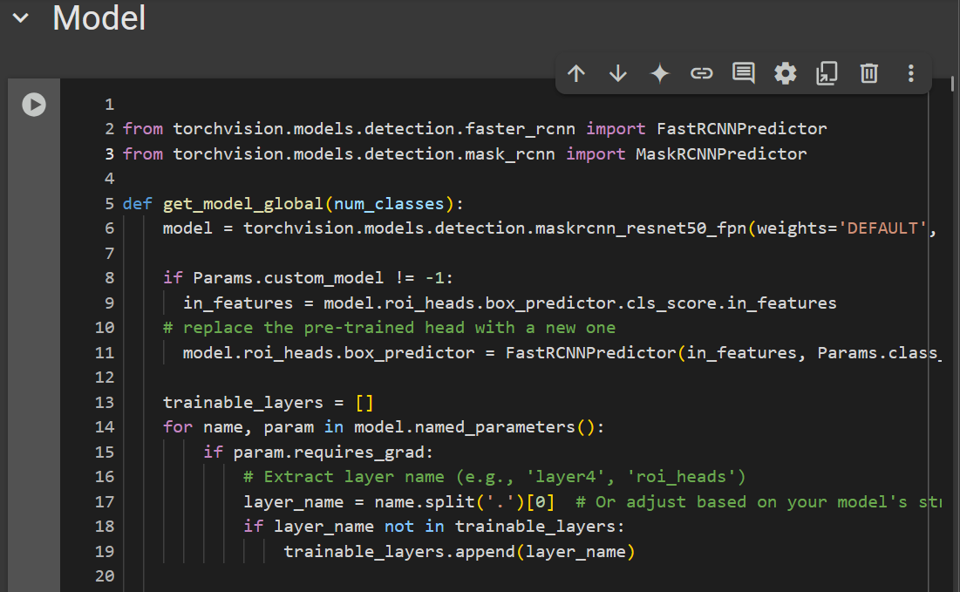
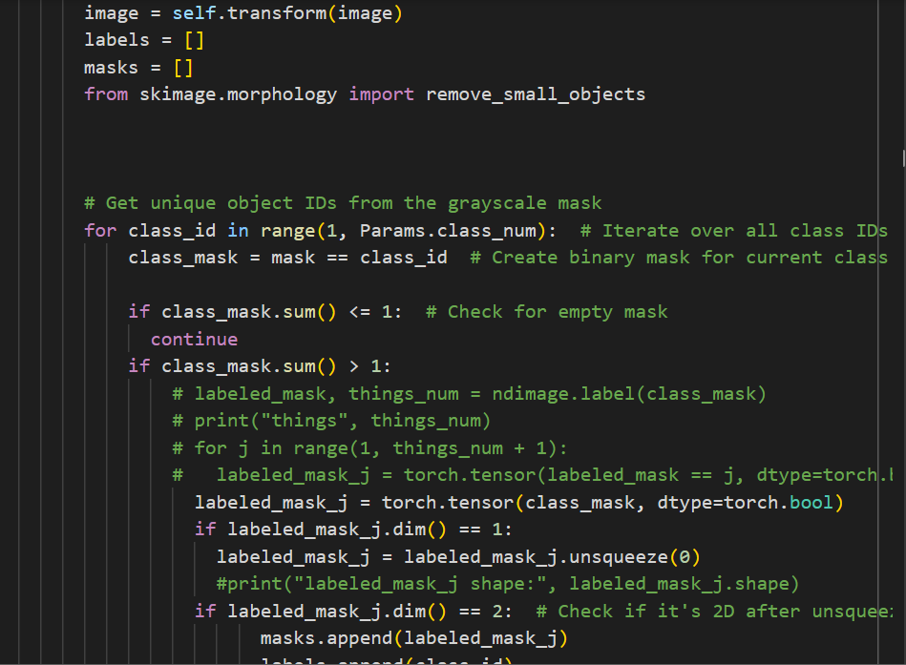
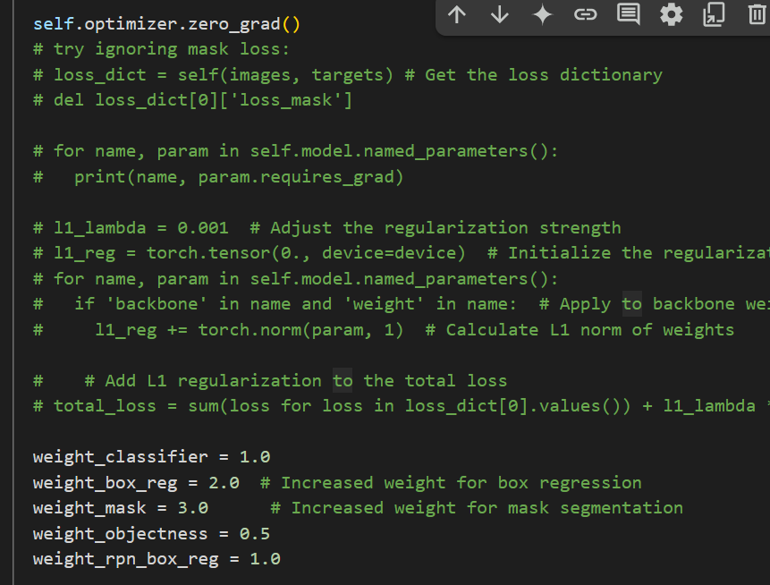
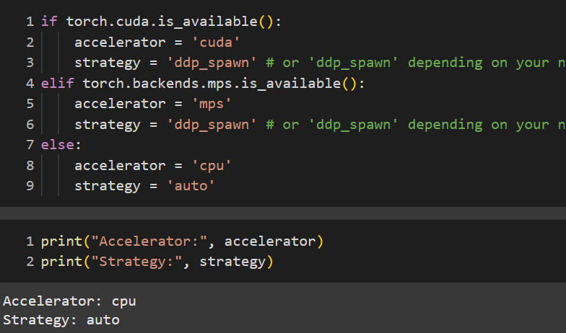
Code

Slide 11
Approaches:
Eliminate small classes (ex. rings) Weighted losses (prioritize mask IOU)
Custom learning rates (descending) Unfreezing layers or freezing them
Shrinking (artifacts from compression) Randomizing layer initial parameters
Architecture dependent computation Increase layer size (between final class)
(cuda child processes incompatible) L2 normalization (Multicoliniarity)
Optimizers (SGD with mom. Vs Adam) Change thresholds (pred. cutoffs)

Slide 12
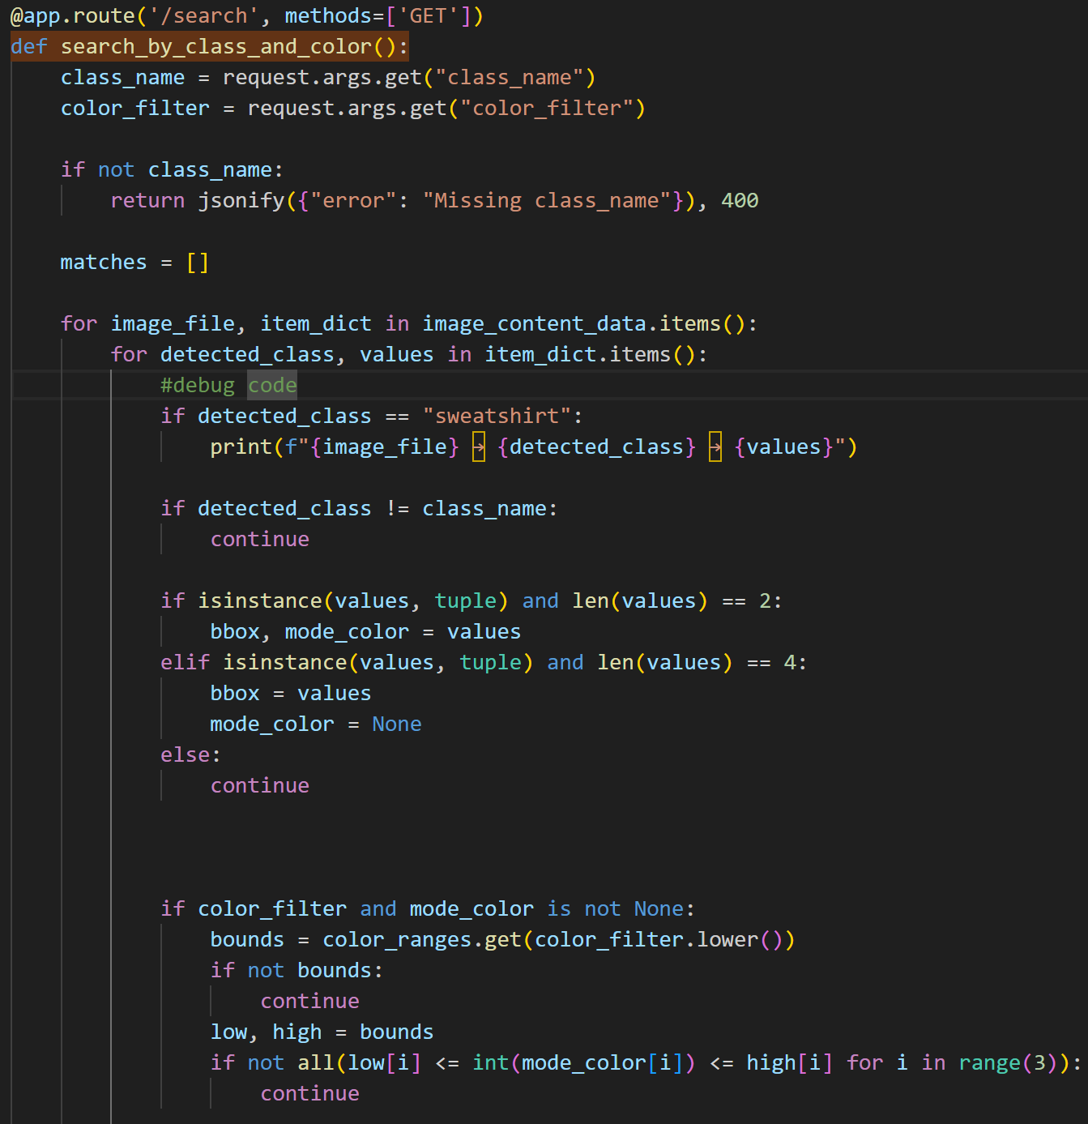
Backend API Overview (Flask)
Key Points:
Written in app.py using Flask
Two main routes:
/upload (simulated keyword + color matching)
/search (filters AI results using class + color)

Slide 13
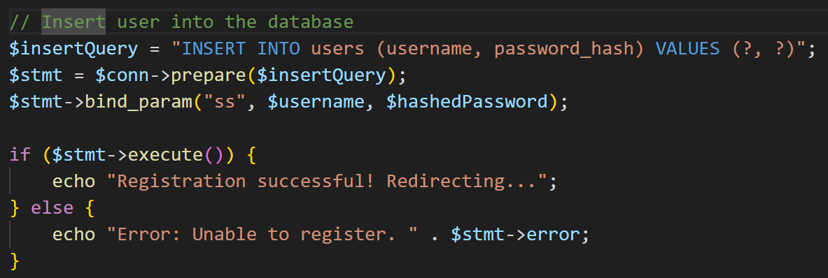
MySQL User Account System
Key Points:
PHP scripts (register.php, login.php) handle user authentication
Passwords are securely stored using password_hash() and we prevent SQL injection by using prepared statements with placeholders (?) and binding user input separately using bind_param(). This makes sure user input is treated as data, not part of the SQL command
User data is saved in a MySQL users table created in phpMyAdmin
SQL injection is a type of attack where hackers enter malicious code into input fields (like login forms) to trick a website into giving them unauthorized access to its database.

Slide 14
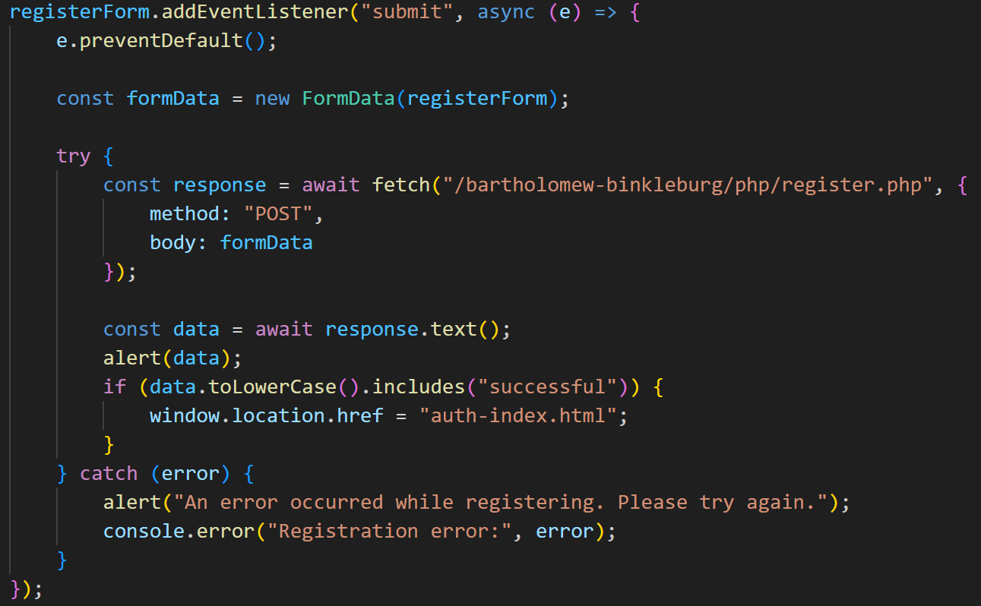
Frontend to PHP: Register & Login
Key Points:
register.html and auth-index.html contain HTML forms
JavaScript captures form data and submits it using fetch()
The response is used to display a message and redirect the user if registration or login is successful

Slide 15
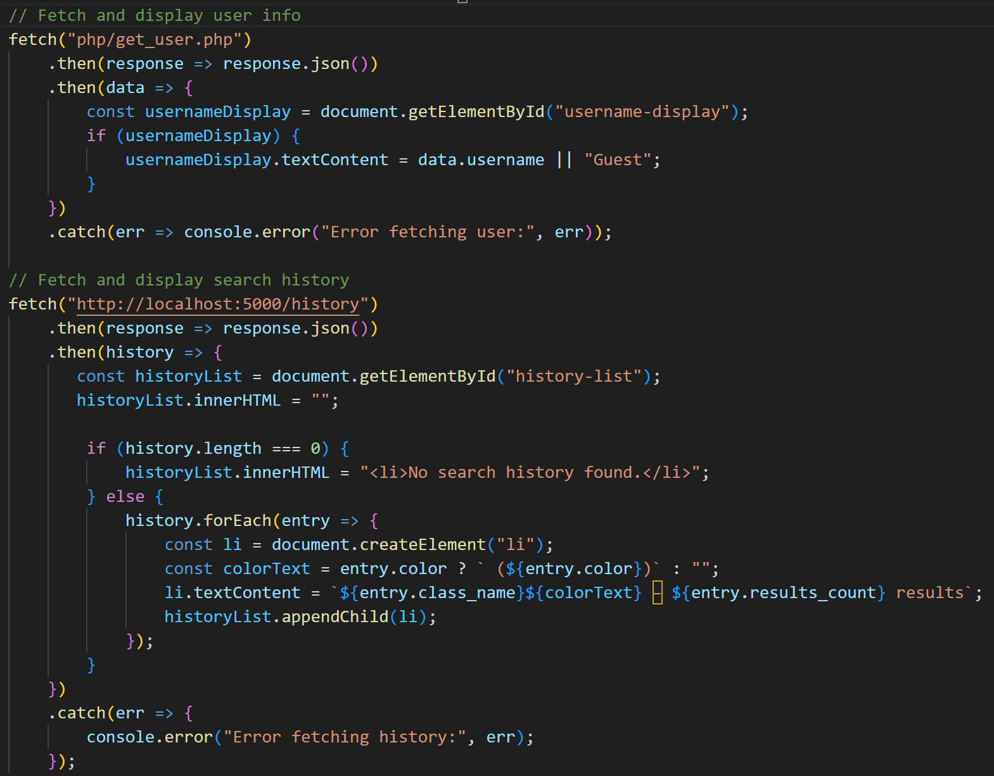
Account Page Functionality
Key Points:
account.html fetches current user info from get_user.php
Search history is loaded dynamically from Flask via /history
JavaScript fills in the page with the user’s name and past searches after loading

